Slide 1

Tellit Solutions
Introduction to Extension Kit
Dan Nylænder

Slide 2




People Platform Ecosystem
Unit4 People Platform
Partner extensions
Apps
Integration Kit
Digital assistant
Smart Automation Services
Customer extensions
Extension Kit
Localizations
Identity and authorization management
External Apps
FP&A
ERP
HCM
Functional Modules
Functional Modules

Slide 3



Unit4 Extension Kit
What is it
As part of the Unit4 People Platform, the Unit4 Extensions Kit delivers low/no-code automation as a Service, extending capabilities of the Unit4 People Experience Platform.
How does it work
Each Extension Flow consists of a trigger, one or multiple actions and a set of conditions. Extension Kit listens to the trigger and then automatically runs the actions if the conditions are met.
When a Supplier is created
Trigger
Search this company in the U.S. Watchlist
Action
If present
Update the Supplier record
Action
And, informs the manager through Wanda
Action
Notes:
Unit4 Extension Kit

Slide 4




Benefits of the Extension Kit tooling
Quickly adapt to new business needs
Automate processes
Improve decision making
Future proof extensions. ERP7 and ERPx
Notes:
Extension Kit helps you respond to new business needs by:
• making Unit4 applications more flexible
• customizing data processing across applications and services
• creating new business logic
• connecting to external services. Chamber of commerce or Peppol directory. Electronic signature of contracts.
It saves time by:
• connecting applications seamlessly, which minimizes the re-keying of data
• applying rules without coding, which streamlines and automates processes
• Create workorders/activities automatically when creating projects. Copy relations from one client to another.
It increases decision-making effectiveness by:
• making information collection better and faster because it is augmented from several sources of data. Credit check!

Slide 5
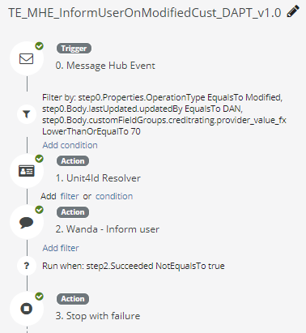
How does it work?
Unit4 Extension Kit gives you access to a customer specific web portal to develop and maintain Extensions Kit flows
Define an Extensions Kit flow:
a trigger
0-many filters and conditions
1-many actions

Slide 6
Triggers
Actions
Scheduler: lets you run jobs on any schedule, triggering punctual or recurring flow executions.
HTTP call: perform an HTTP action on an endpoint (internal or external)
Webhook: Provides an HTTP endpoint that allows other services to trigger your Extension Kit flow via web requests
Digital assistant push text: send information / text to the end user.
Message Hub Events: the flow is initiated when an event happens.
Digital assistant questions: Initiate a conversation with the end user.
Send an e-mail: send an email to a user (internal/external).
Extensions Kit listens to the following events: Workflow events: new tasks, alerts, workflow finished, and custom events declared in Publish event step When an Enterprise Document (business object) is created or changed
Instant UI: Create a simple UI to ask user for input using Wanda
Publish a custom event, Parse a response, …

Slide 7
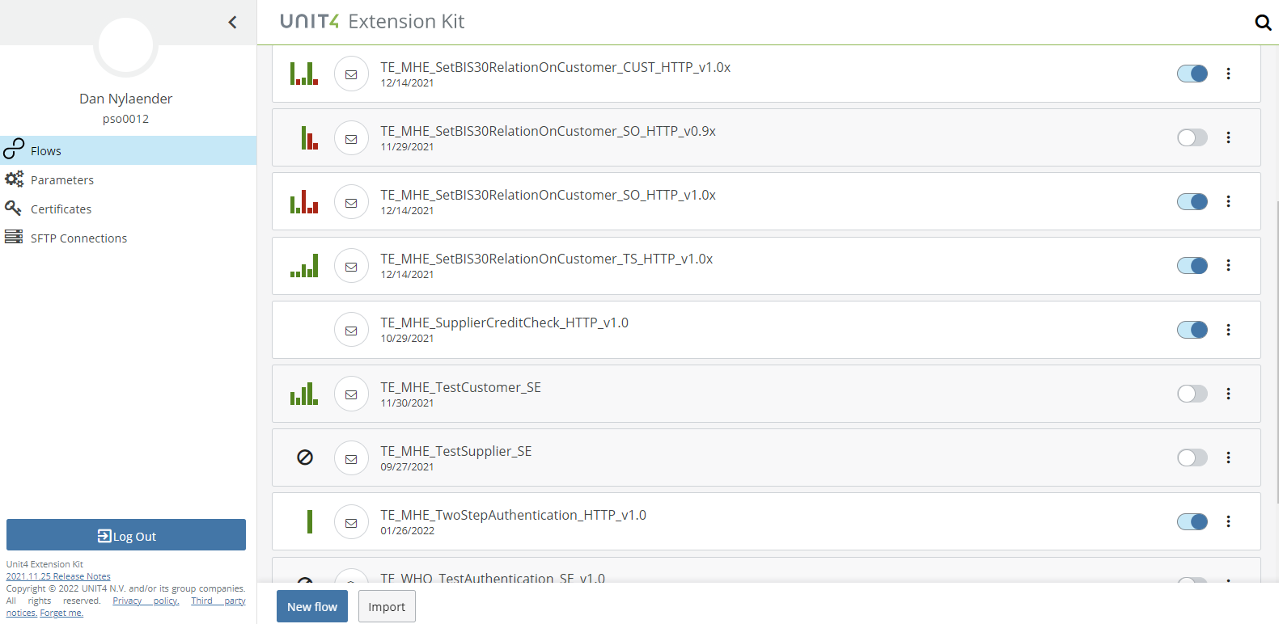
Extension Kit Portal
Right pane shows all your flows
Activate / Deactivate using toggle switch
Customer specific portal
Your company name here
Configure your flows and user access in this menu
Click to define a new flow

Slide 8
Tellit Solutions
Some examples to spawn your creativity
Dan Nylænder

Slide 9

Automation in Unit4 ERP

Slide 10

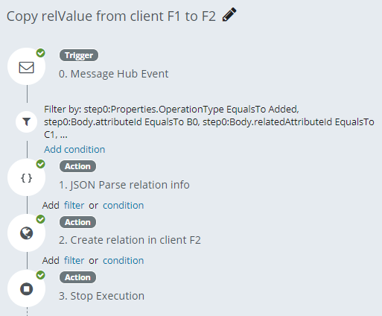
Automation in Unit4 ERP
User story: When a new relation value is defined in company F1, copy it to F2 (or several other companies)

Slide 11
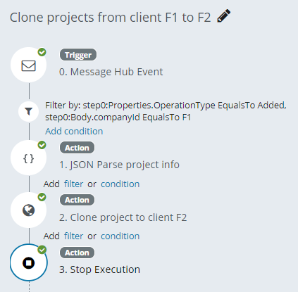
Automation in Unit4 ERP
User story: When a new project is created in company F1, copy it to company F2.
Workorders for the project could also be automatically created

Slide 12
Integrations in Unit4 ERP

Slide 13
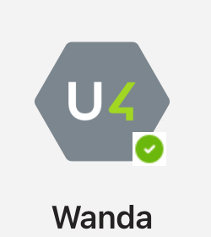
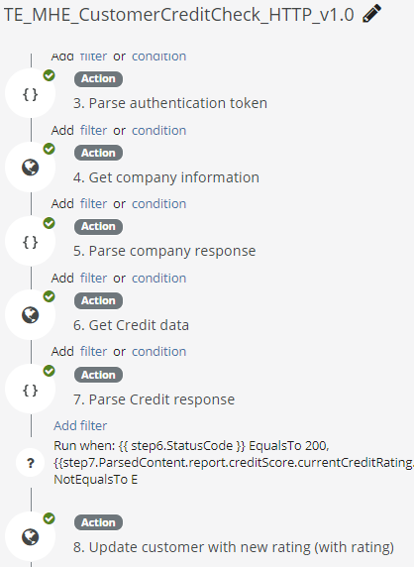
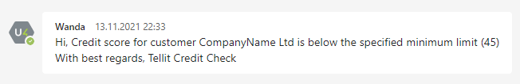
Credit checks in Unit4 ERP - Integration with Creditsafe

Slide 14
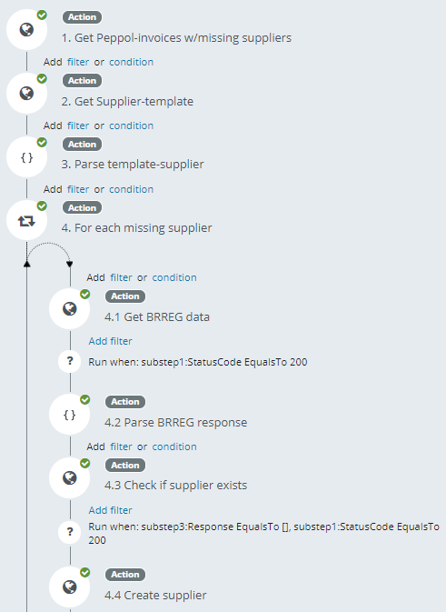
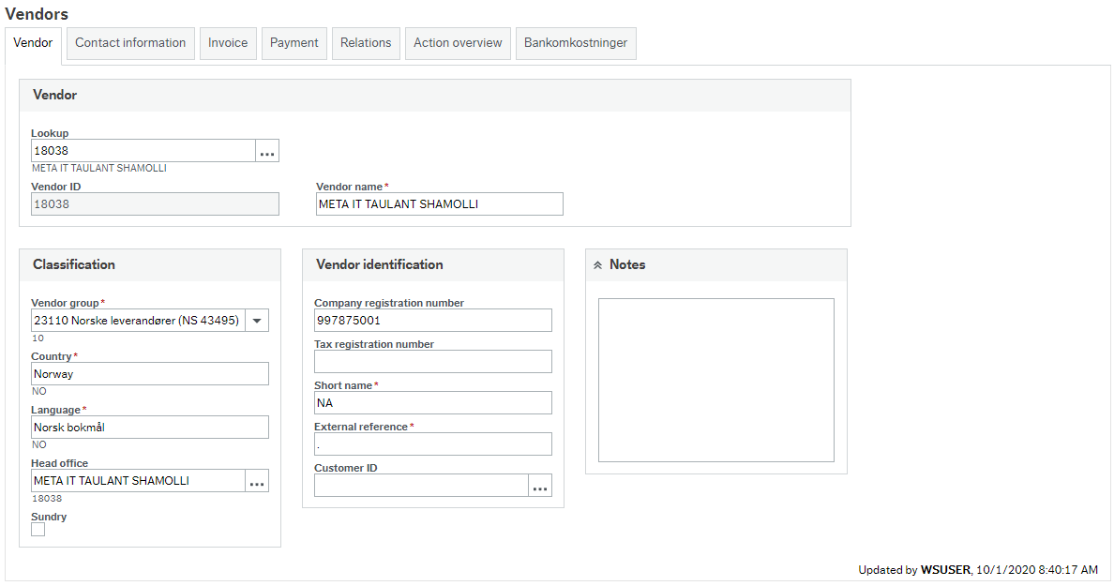
Automatic creations of suppliers - Chamber of Commerce integration

Slide 15
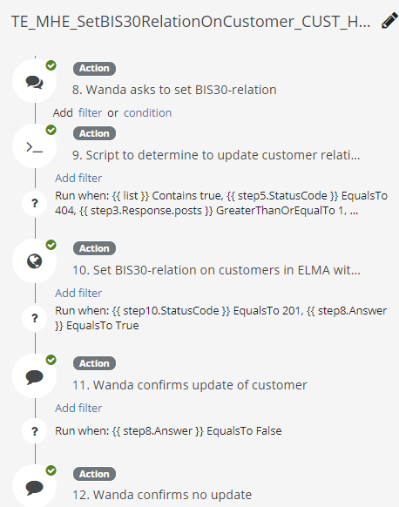
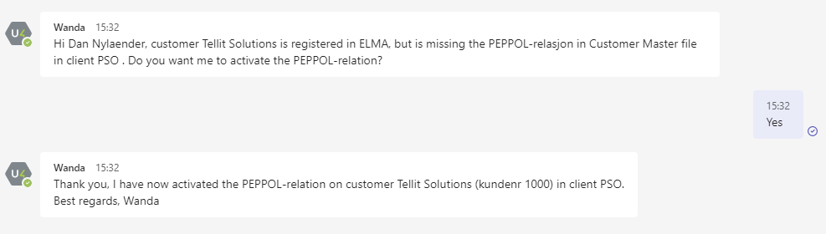
Integration with Peppol directory (SMP) - Update Unit4 ERP using Wanda Questions

Slide 16
Monitoring and alerts in Unit4 ERP

Slide 17
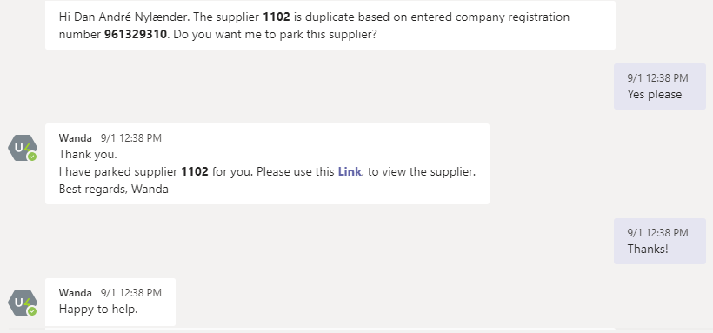
Inform on duplicate suppliers
Wanda Question: Identify duplicate suppliers by listening to the event for creation of new Suppliers. Wanda asks user if the supplier should be parked, and updates ERP based on user feedback in the chat.

Slide 18
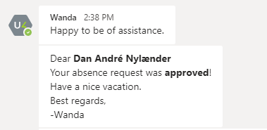
Inform on KPI breaches
Hi Dan André Nylænder The contribution margin for project 1000 is below target.
Best regards, - Wanda
Wanda: Inform project manager when KPI’s
are below targets

Slide 19
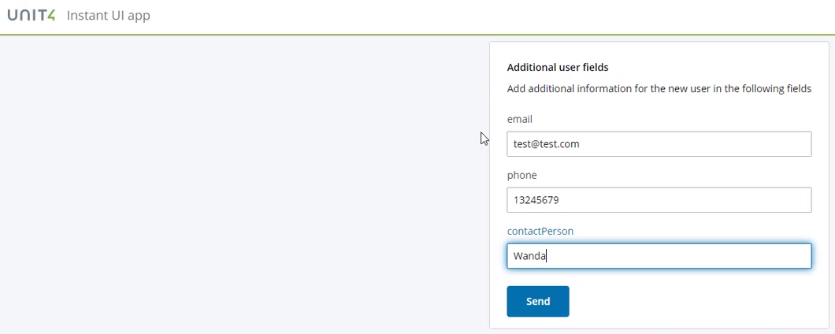
Instant UI – User input with Wanda
Instant UI: Extensions Kit identifies employees who is missing bank account details. Wanda presents a link to a screen, where the employee can enter data. The employee enters its bank account number and pushes Send. This updates the Employee register.
Bank account

Slide 20

Improving Business
Contact Tellit Solutions if you need support: dan@tellitsolutions.no

